Slide 1
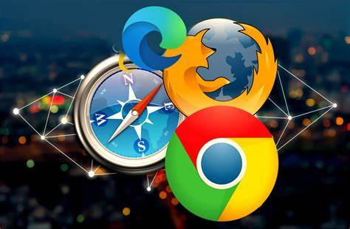
WEB BROWSER
MADE
BY
ANUJ PATEL.

Slide 2
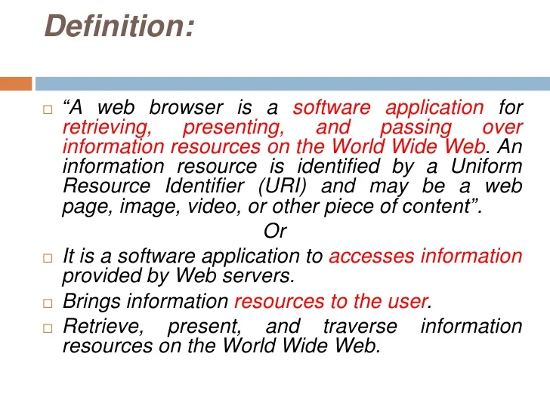
DEFINITION OF WEB browser

Slide 3
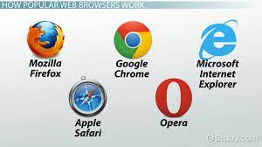
Type of web browser
Internet Explorer
Google Chrome
Mozilla Firefox
Saw
OPera
UC Browser
Brave Browser
Web browsers are programs that allow users to access and interact with websites. They usually have features like history tracking, bookmarking, and tabbed browsing2.
Learn more:
1. quicklearncomputer.com
2. surfshark.com

Slide 4
Feature of web browser
Bookmark
Tools (options)
Browser homepage
Browsing history
View source (code source)
Uniform Resource Locator (URL)
A web browser retrieves information from other parts of the web and displays it on your desktop or mobile device2. It uses the Hypertext Transfer Protocol to transfer information2. A web browser can show text, audio, video, animation and more3.
Learn more:
1. knowcomputing.com
2. mozilla.org
3. tutorialspoint.com
How to change browser settings?
How to clear browsing history?
What is a URL? come to the new Bing

Slide 5

GOOGLE CHROME
Google Chrome is a cross-platform web browser developed by Google. It was first released in 2008 for Microsoft Windows, built with free software components from Apple WebKit and Mozilla Firefox.[15] Versions were later released for Linux, macOS, iOS, and also for Android, where it is the default browser.[16] The browser is also the main component of ChromeOS, where it serves as the platform for web applications

Slide 6
Application
Mozilla Firefox
Google Chrome
Microsoft Edge
Opera
Web Browser & Web Explorer
UC Browser
Vivaldi

Slide 7

OPERA.
Opera is a great web browser that offers a lot of features to make your web browsing experience more secure and private. It has an incognito mode for anonymous browsing, and it can also sync your bookmarks, history, tabs, login and password data across all your devices. It also has a lot of customizable options for changing the look and feel of the browser. Overall, Opera is a great browser for those who want to keep their data safe and secure

Slide 8

UC Browser
UC Browser started life as a web browser designed for mobile devices and became so popular that you can now download a version you can use on your Windows computer too.
Anytime that you want to go online, you need both an internet connection and a web browser. Though some stick to classic options like Internet Explorer or Google Chrome, others like trying new options to get more protection from online threats and to keep their online actions private. A good browser will let you check your email, make purchases, use chat apps, update social networking sites and do research for work or school. UC Browser lets you do all these things and many more too.

Slide 9
Function.
A web browser is an application software helps you explore the world wide web (www) by providing an interface between the server and the client and requesting to the server for web documents and services. It works as a compiler to render HTML which is used to design a webpage. Whenever you search for anything on the internet, the browser loads a web page written in HTML, including text, links, images, and other items such as style sheets and javascript functions.

Slide 10

THANKYOU
MADE
BY
ANUJ PATEL.

